Slide 1
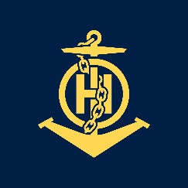
1st Course in Hydrographic Data Processing and Marine Cartography UKHO, Taunton, United Kingdom 7 Sept – 18 Dec 2009
IHO – NIPPON FOUNDATION
ALUMNI SEMINAR
ENGR. TITA P CRUZ
Philippines

Slide 2
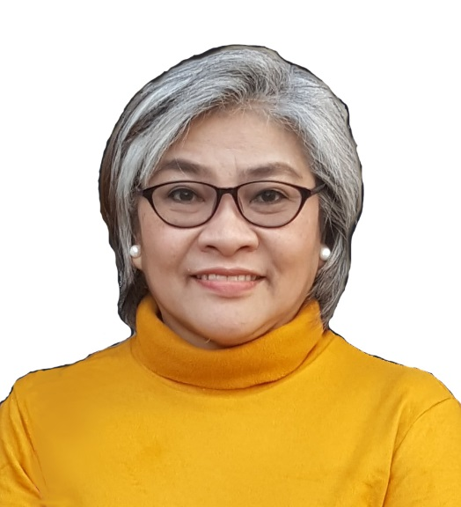
Self introduction
IHO – NIPPON FOUNDATION
ALUMNI SEMINAR
Name | Tita P Cruz
Alumni year | 2009
Country | Philippines
Organization | Hydrography Branch, National Mapping and Resource Information Authority (HB – NAMRIA)
Position/Job title | Chief, Nautical Charting Division
Current job description | Overseeing the publication and compilation of Nautical Charts – Paper and ENC
Please put your photo here!

Slide 3
My career path and projects / Achievements
IHO – NIPPON FOUNDATION
ALUMNI SEMINAR
YEAR | POSITION | PROJECTS/ACHIEVEMENTS
2010 | Chief, Nautical Chart Planning Section | Chart 4466B, 1501,1553, 1554; 4263; 4264 New Chart compilation; Research work, Prepare planning sheets, Textual Information, Data processing and assessment, Notice to Mariners update information, Utilizing quality procedure
 |  | Resource person on 3-day Seminar/Workshop on Basic Marine Cartography and GIS Course (The Nautical Chart and its classification; General Content of a Chart including Symbols and Abbreviations)

Slide 4
My career path and projects / Achievements
IHO – NIPPON FOUNDATION
ALUMNI SEMINAR
YEAR | POSITION | PROJECTS/ACHIEVEMENTS
 |  | Chart 4264 New Chart compilation, Research work, Prepare planning sheets, Sounding selection
2011 | Chief, Nautical Chart Planning Section | Chart 4723A New Edition compilation, Research work, Data Assessment, Review and verification
 |  | Chart 5012 New Chart compilation, Research work, Prepare planning sheets

Slide 5
YEAR | POSITION | PROJECTS/ACHIEVEMENTS
2011 |  | PHDGTH0 Produce new ENC using 7Cs, Quality Assurance, Validate and create Exchange Set
 |  | Chart 4429A, 4446, 4236 New Edition compilation, Update Topographic and Navigational Information, Bathymetric Data Compilation, Gathering Tidal Information and Compass Rose, Cartographic enhancement, Utilizing quality procedure
 |  | Chart 1547 New Chart compilation, Research work, Prepare planning sheets, Sounding selection

Slide 6
YEAR | POSITION | PROJECTS/ACHIEVEMENTS
2012 | Chief, Nautical Chart Planning Section | Charts 1501, 1502, 1535, 1538, 1541, 1542, 1543, 1544, 1545, 1546, 1551, 1564 New Chart compilation, Utilizing quality procedure
2013 | Chief, Nautical Chart Planning Section | Charts 4446, 4447, 4243, 4236, 4230 New Edition compilation; Update Topographic and Navigational Information, Bathymetric Data Compilation, Tidal Information and Compass Rose; Cartographic enhancement; Utilizing quality procedure
 |  | Charts 4453, 4455 New chart compilation, Prepare planning sheet, Assist in the sounding selection process

Slide 7
YEAR | POSITION | PROJECTS/ACHIEVEMENTS
2014 | OIC, Nautical Charting Division | Charts 4254, 4262, 4240, 4241, 4261, 4253, 4469, 2509, 1514, 1544, 1552, 1510 New Chart compilation, Supervise preparation of planning sheets, Review of selected soundings
2015 | OIC, Nautical Charting Division | Charts 4429A, 4446, 4236 New Edition compilation, Supervise Updating of Topographic and Navigational Information, Bathymetric Data Compilation, Gathering Tidal Information and Compass Rose, Cartographic enhancement, Utilizing quality procedure
 |  | Charts 4448B, 4469, 4451, 4433, 4434 New Chart compilation, Supervise preparation of planning sheets, Review of selected soundings

Slide 8
YEAR | POSITION | PROJECTS/ACHIEVEMENTS
 |  | Resource person on Nautical Cartography Training Course (General Content of a Chart including Symbols and Abbreviations) Sept 8-15 and Dec 1-11, 2015
 |  | PH2BHR40, PH2BJM40, PH2KIG40 Published ENC cells
2016 | OIC, Nautical Charting Division | Charts 4270, 4464, 4471, 4647, 4458, 4239, 4602, 4643 New Charts compilation, Supervise preparation of planning sheets, Review of selected soundings
 |  | Charts 1558, 1518, 1530, 1531 New Edition compilation, Supervise Updating of all features

Slide 9
YEAR | POSITION | PROJECTS/ACHIEVEMENTS
2017 | OIC, Nautical Charting Division | Charts 4331, 4636, 4634, 4635, 4332, 4470, 4262 New Chart compilation, Supervise preparation of planning sheets, Review of selected soundings
 |  | PH5ILOH0, PH5DUMNG, PH5ULUGB, PH5MVH50, PH5TBN40, PH5SFDH0, PH5CDOB0, PH5GSN40 Published ENC
2018 | OIC, Nautical Charting Division | Charts 4353, 4341, 4460, 4435, 4436, 4461, 4460, 4247, 4601 New Chart compilation, Supervise preparation of planning sheets, Review of selected soundings
 |  | Charts 1530, 1536, 1549, 4448, 4601, 1531, 1558, 4723A, 4469, 4236 and PH5TCBN40 Published Charts and ENC

Slide 10
YEAR | POSITION | PROJECTS/ACHIEVEMENTS
2019 | OIC, Nautical Charting Division | Charts 4450, 4439, 4215, 4251, 4284 New Chart compilation, Supervise preparation of planning sheets, Review of selected soundings
 |  | Charts 4359, 1529, 1509, 1557, 1505, 1521, PH5ISBEL, Published Charts

Slide 11
Lessons learned from CHART Course
IHO – NIPPON FOUNDATION
ALUMNI SEMINAR
Through this Capacity Building Project, I was given the chance to have a detailed training in Marine Cartography
It gave me a full understanding of the importance of Hydrography
The importance of publishing an accurate and reliable nautical chart for the safety of navigation is always a priority

Slide 12
Lessons learned from CHART Course
IHO – NIPPON FOUNDATION
ALUMNI SEMINAR
One of the most important aspect of the training that I learned is the sounding selection. Don’t just rely from the software output instead see to it that the selected depth by the software comply with the guidelines of sounding selection.
Being able to visit the work areas in the UKHO, listen to the presentations by UKHO specialist and field trips to ports and maritime authorities is a great opportunity
The fact that all our trainers see to it that we learn from what they teach is also a plus factor.

Slide 13
Suggestion for the future
IHO – NIPPON FOUNDATION
ALUMNI SEMINAR
Through this Japan Capacity Building Project, not only the Philippines, but many Hydrographic Offices benefited.
I hope that this project will continue for a long time to develop a pool of efficient and effective marine cartographers for IHO and its member states in producing accurate and reliable charts and ENCs for the safety of navigation.

Slide 14
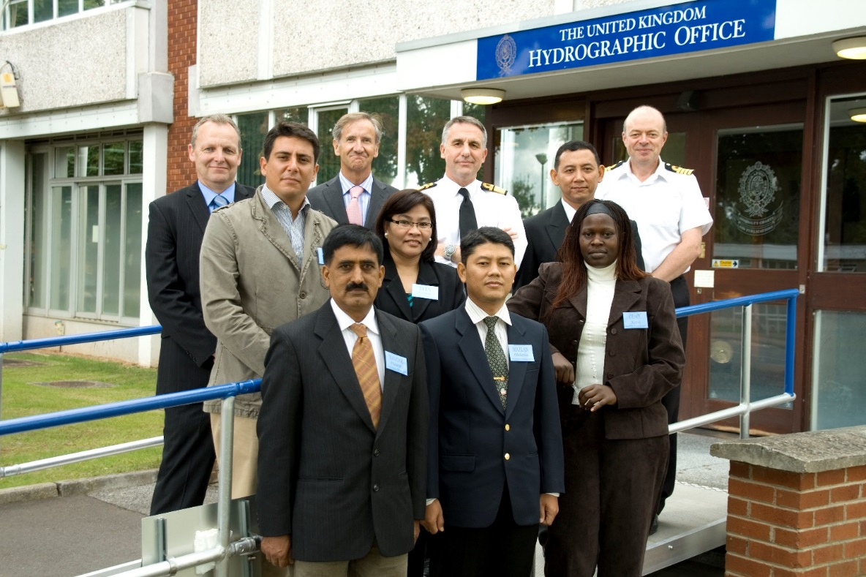
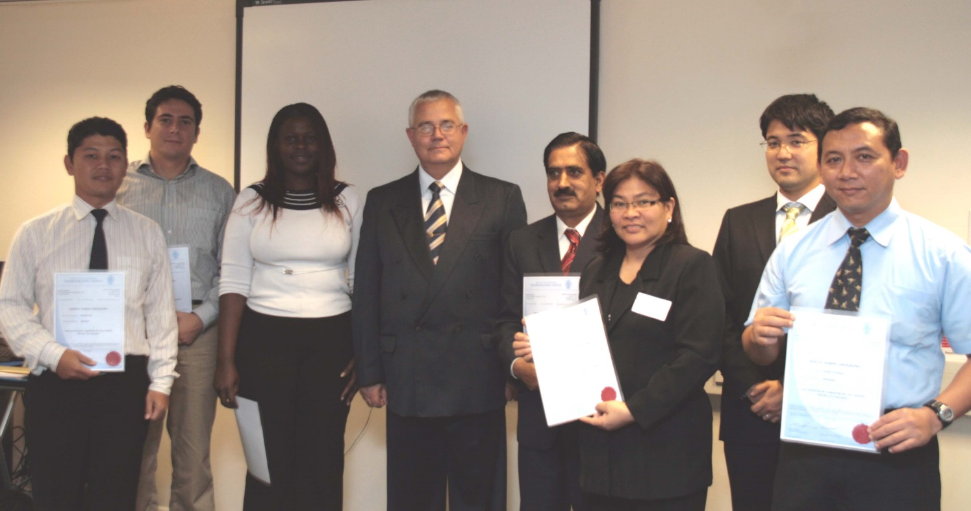
IHO – NIPPON FOUNDATION
ALUMNI SEMINAR
THANK YOU

